Slide 1
A Resilient Hierarchical Checkpointing Algorithm for Distributed Systems Running on Cluster Federation
Presentation by Alireza Tabatabaeian

Slide 2

Table of contents
Introduction
Terminologies
System Model
Proposed Algorithm
Performance Comparison
Simulation Results
Conclusion

Slide 3
Introduction
Today, cluster architectures are very widely spread in the research arena and in the industries.
Resources can be volatile because the nodes can get disconnected when the connection is lost or hardware failure occurs
Thus, the risks of occurrence of faults
become very high; these faults would cause failures that prevent the correct execution of the distributed applications
In distributed systems, fault-tolerance can be ensured by using checkpointing techniques

Slide 4
Terminologies

Slide 5
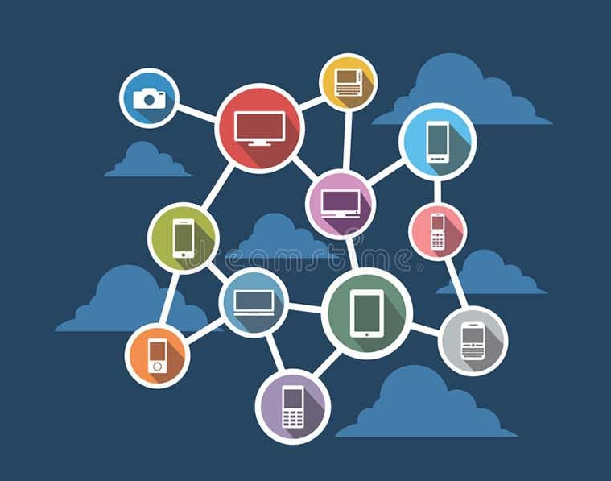
Terminologies
Distributed Systems
A collection of independent computers (nodes) that appear to the user as a single system.
concurrency, no global clock, and independent failures.
Cloud computing platforms like AWS or federated Kubernetes clusters.
Example:
Key Properties:
What?

Slide 6

Terminologies
Distributed Systems
Checkpointing
The act of saving the current state of a process or system to stable storage so that it can resume from that point in case of failure.
To reduce loss of progress after crashes.
Like saving a game — you reload from your last save if the game crashes.
Example:
Why?
What?
Non-blocking Checkpointing
Recovery Line

Slide 7
Terminologies
Distributed Systems
Checkpointing
Cluster
A group of tightly connected computers (often in the same location or network).
Nodes in a cluster share resources and often use System Area Network (SAN) to communicate efficiently.
How?
What?

Slide 8
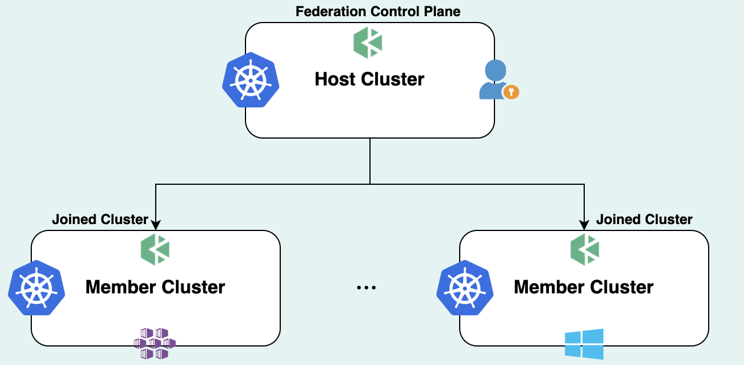
Terminologies
Distributed Systems
Checkpointing
Cluster
Cluster Federation
A union of multiple clusters connected over a LAN or WAN.
Used to scale applications across data centers, geographical locations, or institutions.
A research computing system where universities share compute clusters.
Example:
Use case:
What?
Fail-Stop Model

Slide 9
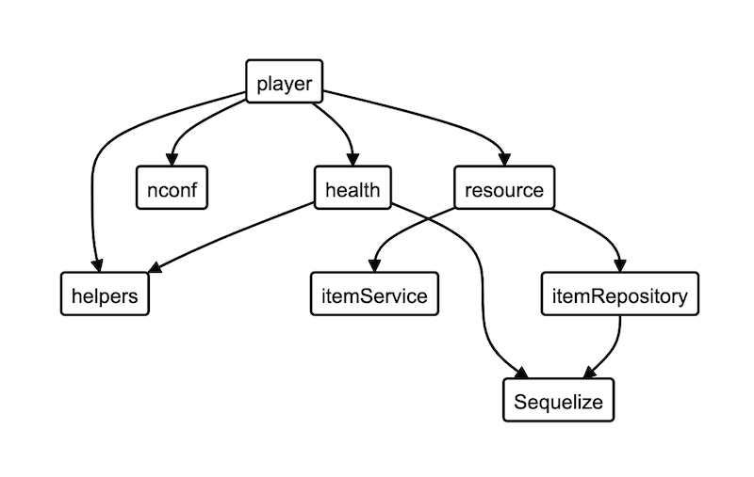
Terminologies
Distributed Systems
Checkpointing
Cluster
Cluster Federation
Dependency Graph

Slide 10
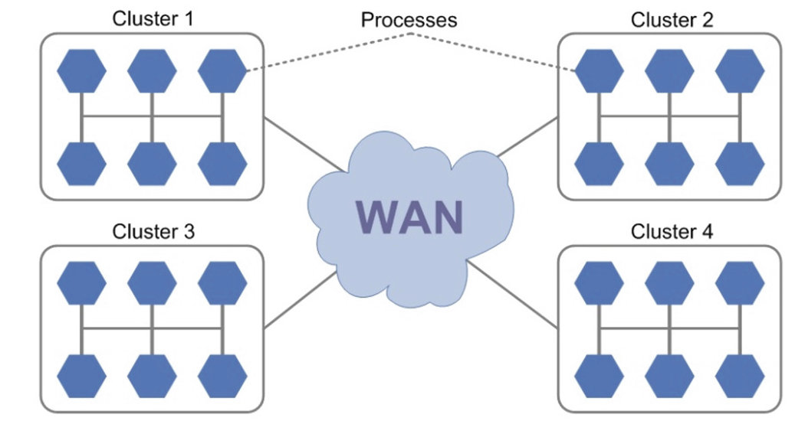
System Model
Formula
Communications
SAN
(Intra)
LAN/WAN
(Inter)
Assumptions
Fail-Stop
No shared memory/clock
N = M*K
Reliable message passing
Any process can initiate checkpointing

Slide 11
Related Works

Slide 12
Related Works
Centralized and Mirroring
Central File Server Checkpointing
Every process saves its state to a central server.
Pros: Simple and easy to manage.
Cons: Scalability bottleneck and single point of failure.
Checkpoint Mirroring
Each process duplicates its checkpoint on another node (mirror).
Pros: Fast recovery if original node fails.
Cons: Higher resource usage (bandwidth, storage); doesn’t scale well.
*Both methods are useful in small systems but problematic in large federated environments.

Slide 13
Related Works
Centralized and Mirroring
Skewed Checkpointing
Processes take checkpoints at different times to reduce contention and storage load.
Evaluation model: Stochastic analysis of recovery overhead.
Result: Skewed checkpointing was found to be more efficient than centralized or mirrored methods.
*Not all processes need to checkpoint at the same time.

Slide 14
Related Works
Centralized and Mirroring
Skewed Checkpointing
Sender-Based Message Logging
Problem addressed
Lost or orphan messages in inter-cluster recovery.
How it works
Sender logs every sent message.
Drawbacks
Logging every message causes overhead.

Slide 15
Related Works
Centralized and Mirroring
Skewed Checkpointing
Sender-Based Message Logging
Non-blocking coordinated checkpointing
How it works
Clusters take coordinated checkpoints without stopping execution.
Goal
Avoid domino effect and unnecessary rollbacks.
Key Benefit
Even concurrent failures can be recovered without redoing everything.

Slide 16
Related Works
Centralized and Mirroring
Skewed Checkpointing
Sender-Based Message Logging
Non-blocking coordinated checkpointing
Efficient Recovery Algorithm
Key Feature
Independent of specific cluster federation architecture.
Limitation
Message logging and checkpointing handled separately → higher complexity.

Slide 17
Related Works
Centralized and Mirroring
Skewed Checkpointing
Sender-Based Message Logging
Non-blocking coordinated checkpointing
Efficient Recovery Algorithm
Low-Cost Non-Blocking algorithms
Focus
Minimize messages and storage cost
Strategies
Checkpoint fewest number of processes
Each cluster manages its own metadata (decentralized)
Bounded intervals to avoid domino effect
Problem
not yet integrated with optimistic logging.

Slide 18
Related Works
Wrap Up
Term | Meaning
Checkpointing technique | A general strategy or method used to save and recover program state in a distributed system.
Checkpointing algorithm | A specific, formalized step-by-step procedure to implement a technique (e.g., with pseudocode, message handling rules, data structures).

Slide 19
Related Works
Wrap Up
Name/Category | Type | Problem Addressed
Central file server / Mirroring / Skewed | Techniques | How to store checkpoints efficiently (but limited scalability).
Sender-based logging | Algorithm | How to recover from lost inter-cluster messages.
Non-blocking coordinated checkpointing | Algorithm | How to avoid blocking & domino effect in recovery.
Hybrid checkpointing (coordinated + comm-induced) | Technique + Algorithm | Handle tightly-coupled applications across clusters.
Efficient architecture-independent recovery | Algorithm | Fast recovery without depending on network layout.
Low-cost non-blocking checkpointing | Algorithm | Reduce number of messages and storage operations.
Domino-effect free concurrent recovery | Algorithm | Crash recovery for concurrent failures in federated clusters.

Slide 20
Proposed Algorithm

Slide 21
Proposed Algorithm
Optimistic logging
(inter-cluster)
Non-blocking coordinated checkpointing (intra-cluster)
Combine

Slide 22
Proposed Algorithm
if
inter-cluster messages>5/s
Then
logging enabled
Combine
Adaptive trigger

Slide 23
Proposed Algorithm
Combine
if
inter-cluster messages>5/s
Then
logging enabled
Adaptive trigger
Goals
Low message overhead
Fast and minimal rollback
Avoid blocking
Maintain consistent global state

Slide 24
Proposed Algorithm
Combine
if
inter-cluster messages>5/s
Then
logging enabled
Goals
Low message overhead
Fast and minimal rollback
Avoid blocking
Maintain consistent global state
Adaptive trigger
“Clusters independently take notes (checkpoints) while message messengers (between clusters) keep logs only if the chatter becomes too noisy.”

Slide 25
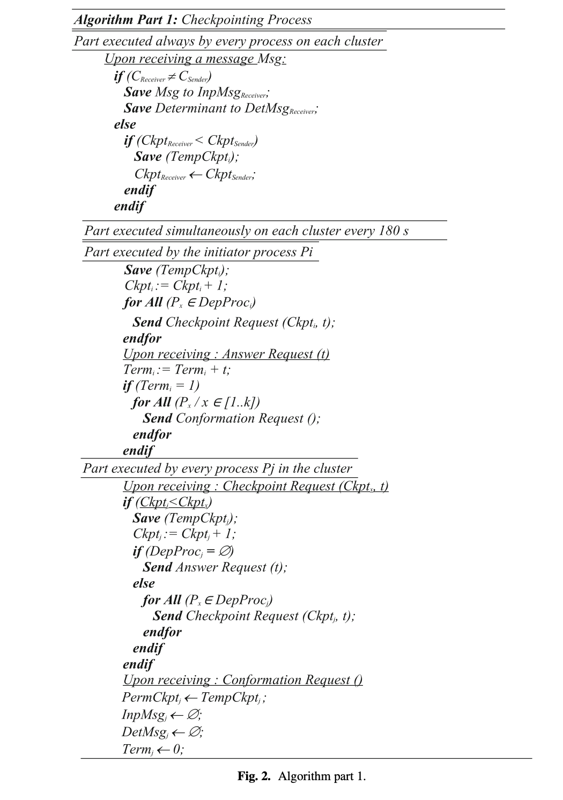
Checkpointing – Algorithm Mechanics

Slide 26
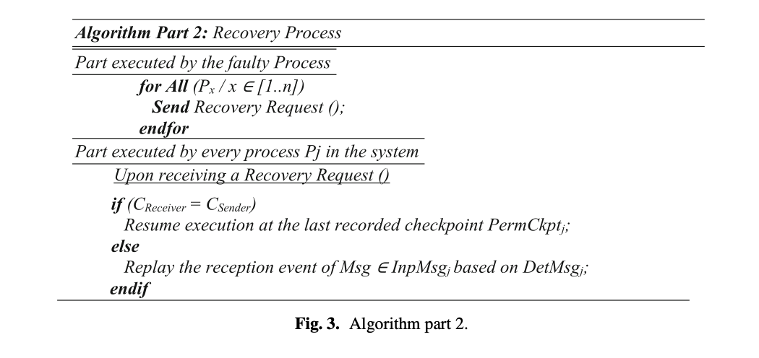
Checkpointing – Algorithm Mechanics

Slide 27
Recovery Implementation
Upon failures
All processes in the affected cluster roll back to last permanent checkpoint
Other clusters replay inter-cluster messages using determinants from DetMsg
Determinants
{SeqNum, SendTime, ReceiveTime}
Recovery Ensures
No domino effect
Consistent global state
Minimum re-execution
Only local data + inter-cluster logs needed → Efficient!

Slide 28
Performance Comparison

Slide 29
Performance Comparison
Metric | Proposed alg | others
Architecture dependant | ❌ | ✅(Mostly)
Domino effect | ❌ | ✅(Often)
Handles concurrent failures | ✅ | ❌ (Often)
Blocking | ❌ | ❌✅
Message complexity | O(n) | O(kn), O(n²), etc
Stable storage trips | ✅ Minimal (k) | ❌ Higher (k + r)
Conclusion: Efficient and scalable, especially in federated setups.

Slide 30
Simulation Results

Slide 31
Simulation Results
Simulator: ChkSim
Clusters tested: 5, 10, 20

Slide 32
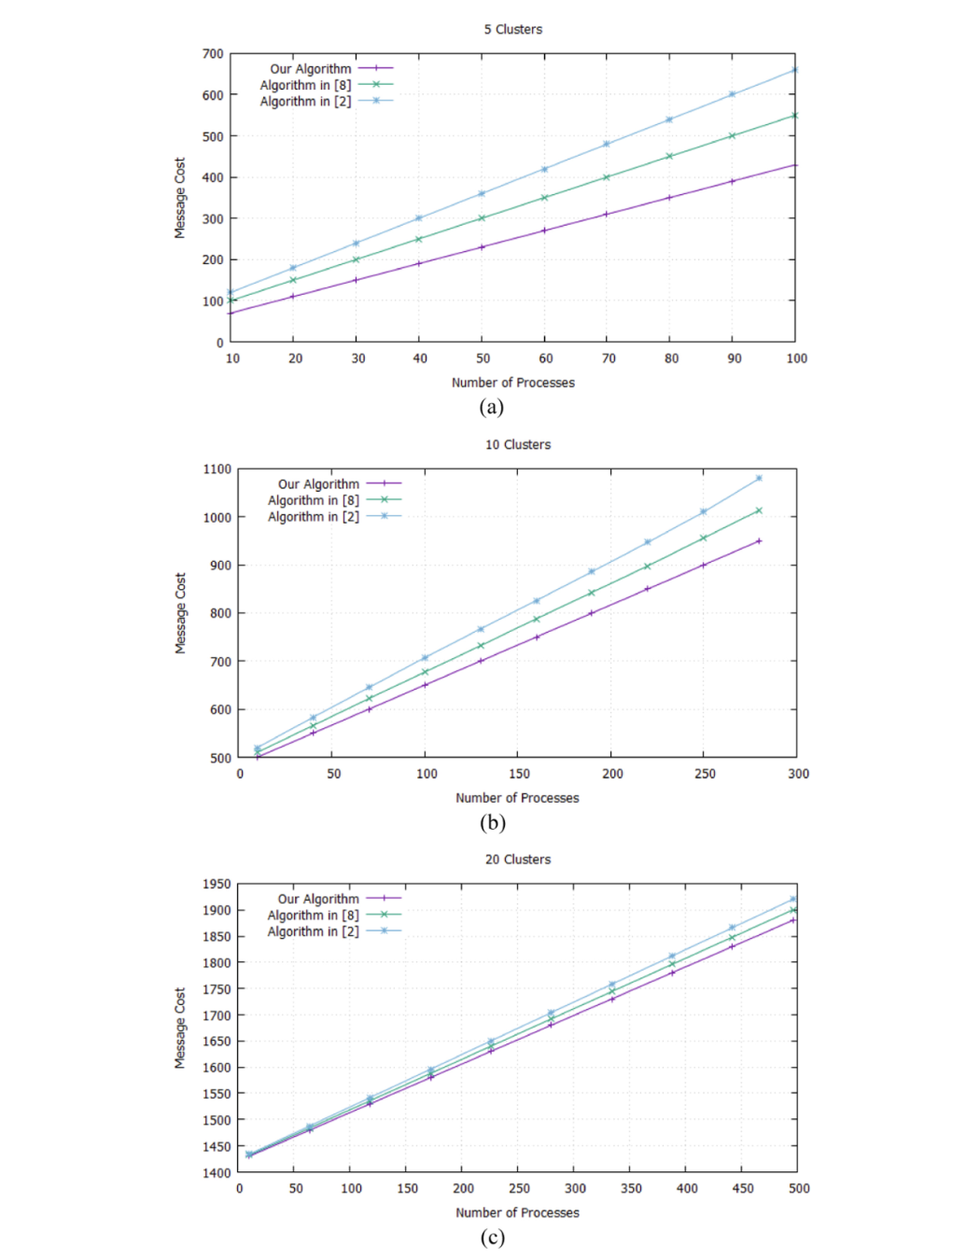
Simulation Results
Simulator: ChkSim
Clusters tested: 5, 10, 20

Slide 33
Simulation Results
Simulator: ChkSim
Clusters tested: 5, 10, 20

Slide 34
Simulation Results
Simulator: ChkSim
Clusters tested: 5, 10, 20

Slide 35
Simulation Results
Simulator: ChkSim
Clusters tested: 5, 10, 20
consistently uses fewer messages
efficient when: Large number of processes/Clusters

Slide 36
Conclusion

Slide 37
Conclusion
A resilient hierarchical checkpointing algorithm for federated clusters
Combines best of coordinated and logging-based recovery
Avoids blocking, low message overhead, and domino-effect free
Suitable for large-scale, fault-prone systems

Slide 38
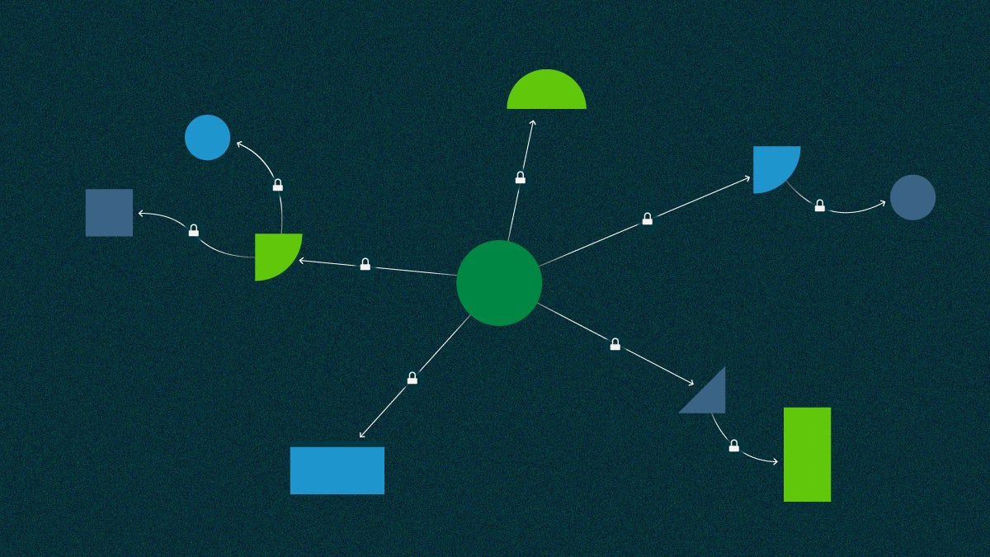
Thanks
Presented by Alireza Tabatabaeian

